Slide 1
Driving Data Dialogue
Engaging staff with visualisation of school analytics
Ben Hicks Oxley College
Notes:
Talk about who am I here – teacher with a hobby, that developed into a habit…

Slide 2
1. Why?
2. Cognition and Design
3. Measuring Impact
4. Enabling Dialogue
5. Pitfalls
Notes:
We have a spyglass, and it is the ever emerging software for data analysis

Slide 3

What was observed by us…with the aid of the spyglass, may be observed so well that all the disputes that for so many generations have vexed philosophers are destroyed by visible certainty, and we are liberated from wordy arguments.
Galileo Galilei – from Starry Messenger
I hope you will get out of today:
strategies for engaging staff in talking about data
theories and principles of effective data visualisation
an idea of some of the pitfalls of preparing data to be seen
Notes:
We have a spyglass, and it is the ever emerging software for data analysis.
Make the previously unseeable, seen.

Slide 4
Why?
Why collect, visualise and share data?
To find truth, and then learn from it.
Schools are already data rich, and we often don’t use it well.
Helping people engage with data helps broaden the conversation.

Slide 5
GATHERING DATA
ANALYSE & VISUALISE
SHOW DON’T TELL – ALLOW STAFF TO DRAW LOGICAL CONCLUSIONS
VALIDATE STAFF KNOWLEDGE & CAPACITY
SCHOOL REFLECTS ON PROGRESS & MAKEs MOST EFFECTIVE CHANGES
STAFF MEANINGFULLY ENGAGE WITH DATA
STIMULATE EFFECTIVE DISCUSSION

Slide 6
2. Cognition and Design
Everything I have learned so far (thanks to Edward Tufte, Alberto Cairo, Andy Kirk, many R-bloggers and my own mistakes)
Vision is fast, reason is slow
Visualisation happens in the mind
Notes:
The eye takes in information at 20 Mbits per second. It takes in a huge amount of data quickly. But people need time to form a mental model – a mental model / make meaning.
Visualisation happens in the mind.– design for this by...keeping the visualation simple and clear to support the thinking that you want to happen
The data is the star. The story is the hero.
Data – Ink ratio. Get rid of chart junk. Reason I like R. Keep it simple, and recognisable. Iconic memory [sketch a face] Design for exploration is different, however.

Slide 7
The scale
A. Cairo (2013)
Notes:
The eye takes in information at 20 MB per second. It takes in a huge amount of data quickly
Visualisation happens in the mind. Iconic memory [sketch a face] – design for this by We want showing and thinking to become one.
The data is the star. The story is the hero.
Data – Ink ratio. Get rid of chart junk. Reason I like R. Keep it simple, and recognisable. Design for exploration is different, however.

Slide 8
2. Cognition and Design
Everything I have learned so far (thanks to Edward Tufte, Alberto Cairo, Andy Kirk, many R-bloggers and my own mistakes)
Vision is fast, reason is slow
Visualisation happens in the mind
The first thought should be ‘what does that mean?’ not ‘how did they do that?’
Assist the viewers cognitive task in viewing evidence
Notes:
The eye takes in information at 20 Mbits per second. It takes in a huge amount of data quickly. But people need time to form a mental model – a mental model / make meaning.
Visualisation happens in the mind.– design for this by...keeping the visualation simple and clear to support the thinking that you want to happen
The data is the star. The story is the hero.
Data – Ink ratio. Get rid of chart junk. Reason I like R. Keep it simple, and recognisable. Iconic memory [sketch a face] Design for exploration is different, however.

Slide 9
Allows more accurate comparisons
Allows more generic judgements
The scale
A. Cairo (2013)
Notes:
Cleveland and McGill’s elementary perception tasks.
Scale to the left is for more accurate pre-attentive comparisons (comparisons without thought / reason)
That’s the philosophy behind the how, lets look at some examples.

Slide 10
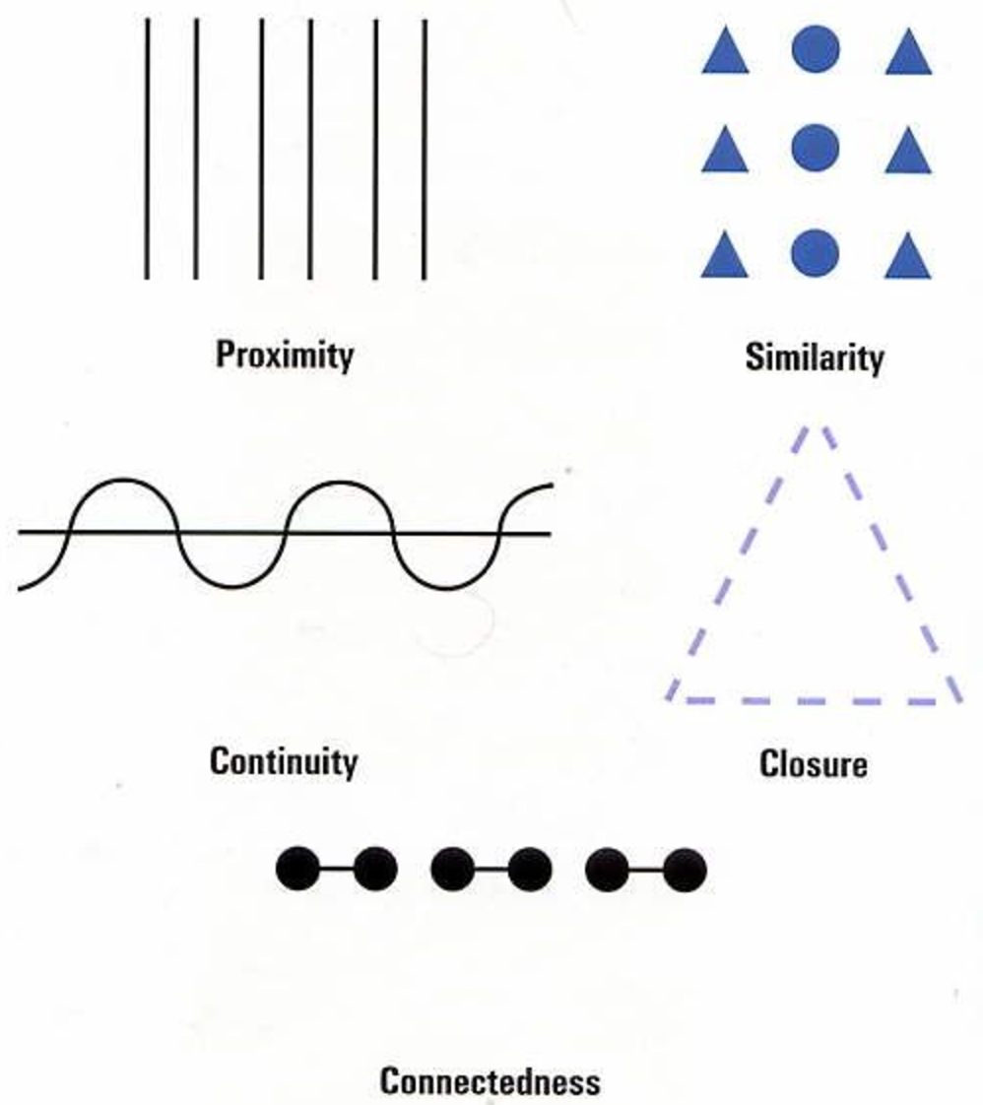

Slide 11
Lessons - Cognition and Design
The visual brain has evolved to quickly do two main things:
detect patterns
categorise and distinguish
As much as possible, design with this in mind.
The brain loves difference – but difference is a finite resource
Notes:
This is why when you wake up and see shirt hanging on a doorknob in your bedroom it has already detected the pattern of a person and categorised it into a human intruder and before you are even awake has decided to give your body a massive dose of adrenaline which is oh so helpful for then going back to sleep

Slide 12
3. Measuring Impact
Achievement
Growth

Slide 13
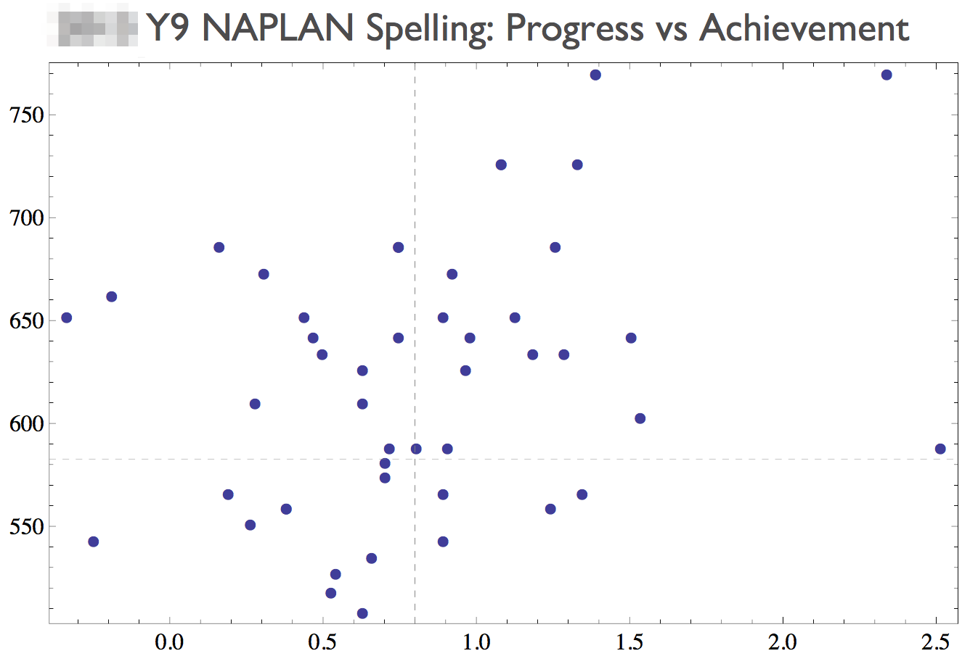
Low growth, high achievement
High growth, high achievement
Low growth, lower achievement
High growth, lower achievement
Notes:
Vertical axis – measures Y9 NAPLAN score, horizontal marker is the state average
Horizontal axis – measures the growth from Y7 to Y9, standardised as an effect size. The vertical dotted line is a 0.8 effect size.
Each dot is an individual student.
Go through quadrants.
What did you notice first? What staff noticed. What staff talked about

Slide 14
Notes:
* Being drawn to extremes / differences

Slide 15
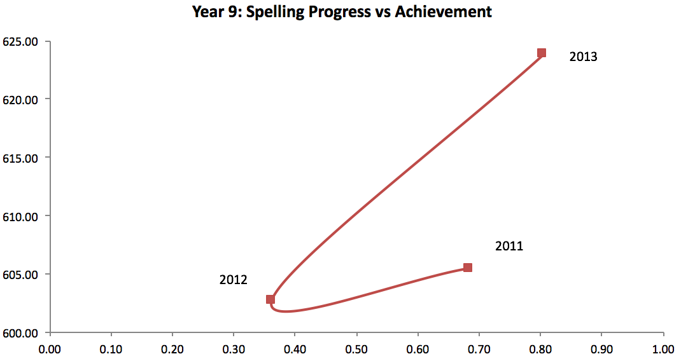

Slide 16
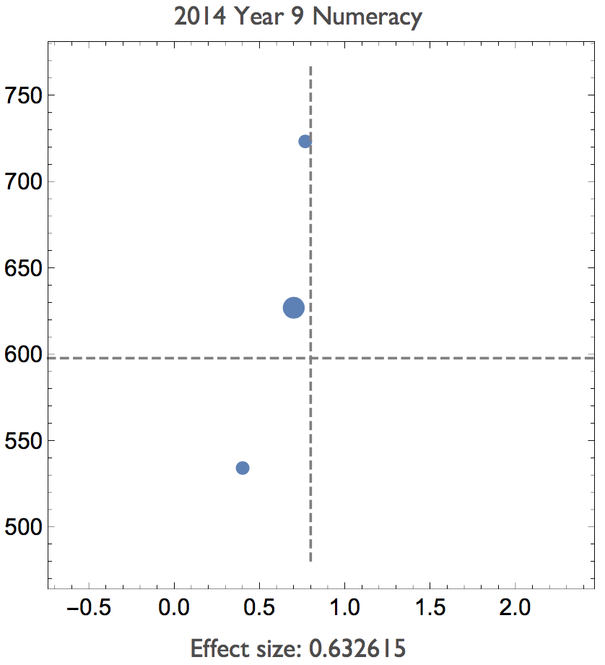
Top 25% (based on Y9 NAPLAN)
Middle 50%
Lowest 25%
Notes:
Promoted discussion on what classroom strategies were working for different groups of students, without being side-tracked by individuals

Slide 17
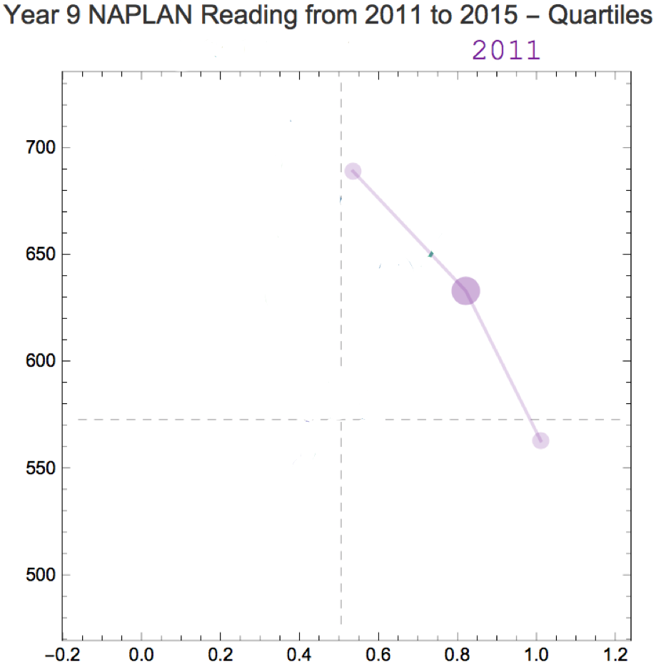
Notes:
Connecting lines groups objects together >> shape and colour
Want to add multiple years to tell the story of our impact over time.

Slide 18
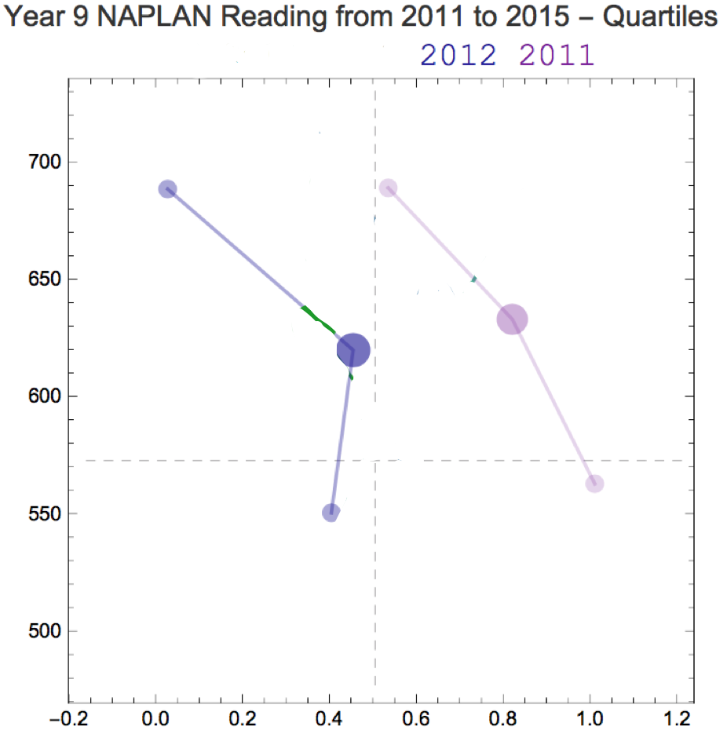
Notes:
Connecting lines groups objects together >> shape and colour
Want to add multiple years to tell the story of our impact over time.

Slide 19
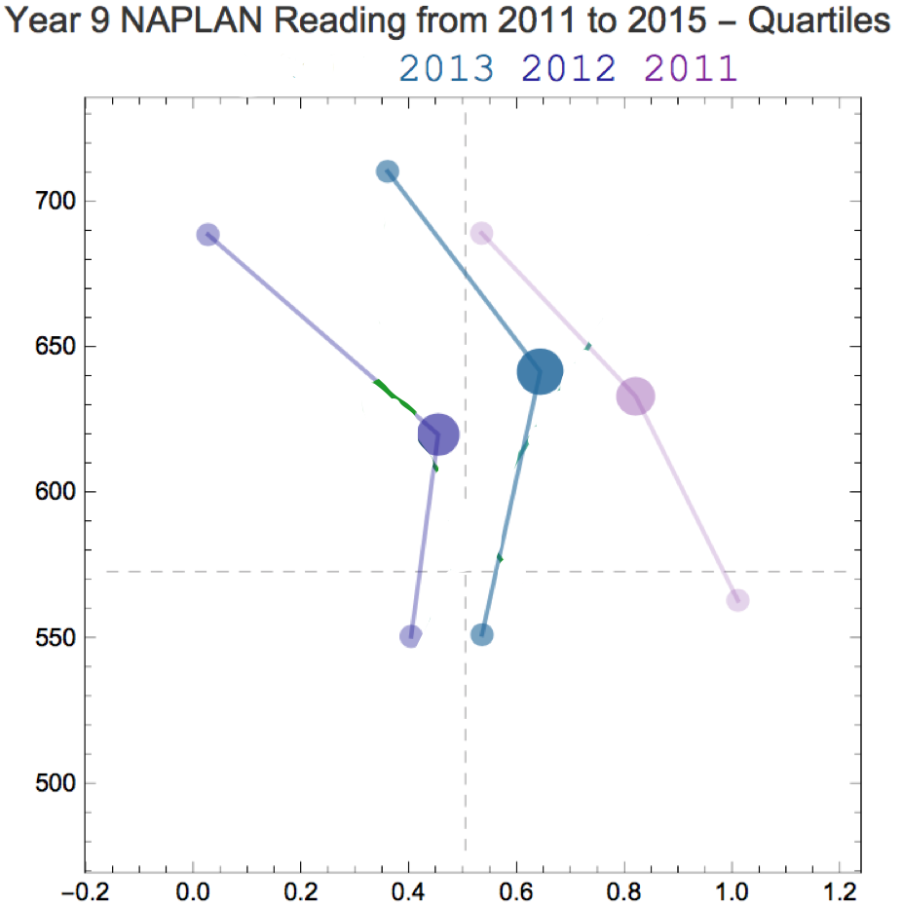
Notes:
Connecting lines groups objects together >> shape and colour
Want to add multiple years to tell the story of our impact over time.

Slide 20
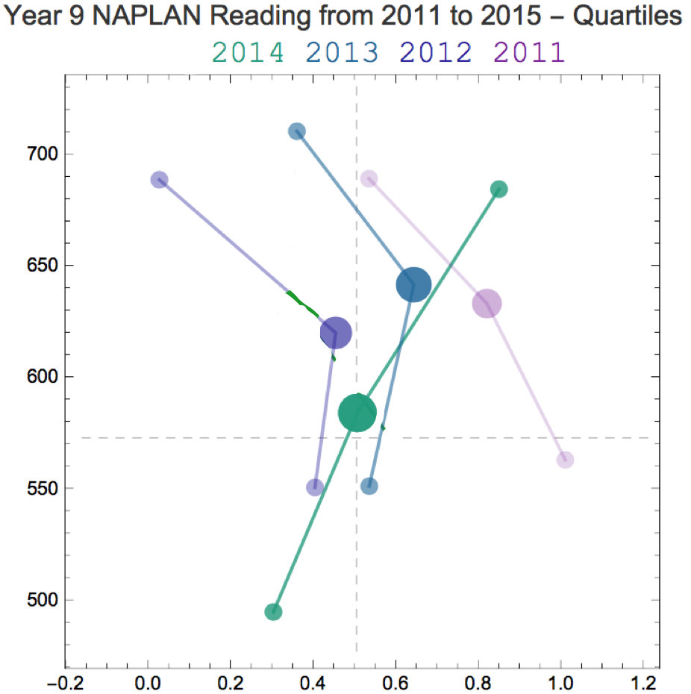
Notes:
Connecting lines groups objects together >> shape and colour
Want to add multiple years to tell the story of our impact over time.

Slide 21
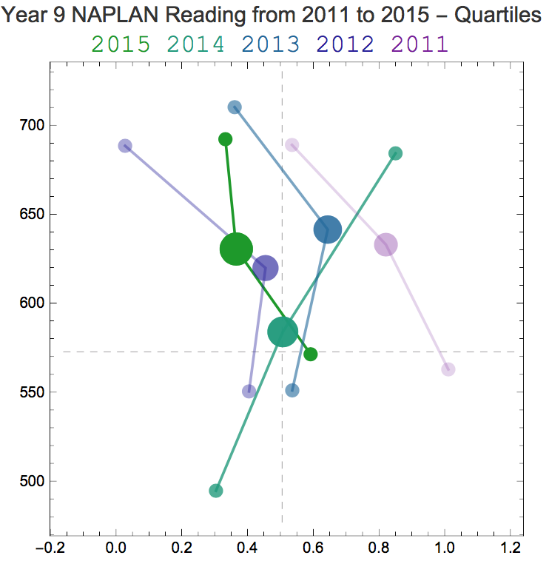

Slide 22
Notes:
DISCUSS HANDOUT
Cluster the middles together, to get a better feel of our impact on the middle group of students

Slide 23
Lessons from Measuring Impact
Aggregate intelligently because outliers will drive dialogue.
Design to get the viewer to the story first
Don’t expect the story to be simple.
Always ask – how do I know that?

Slide 24
4. Enabling Dialogue
Validate staff experience
Do not underestimate your staff’s desire to engage with the data
Enable staff to draw their own conclusions. Show – don’t tell.
Presentation mode.
Build trust.
Notes:
Staff are already collecting anecdotal data all the time on their students.
They will be willing to engage, but there is fear involved that needs to be overcome. What will the data say? How will I be judged? Will I be able to understand? Will this data match with this anecdotal evidence?
When you are (possibly) challenging staff preconceptions it can be very confronting (challenging someone’s view of reality). It is more comfortable if staff come to their own conclusions – and this might be over a period of time. They might be more willing to shift positions (and reflect on their own practice) if they don’t feel dictated to. ------ If you tell, then they haven’t engaged. Maths example.
Powerpoint vs paper
Trust: everything above.

Slide 25
Numbers on the screen are representations of the real world.
Look at the real world, not just representations. Walk around what you want to learn about.
Edward Tufte
Notes:
Walkthrough data – to collect this was initially confronting for staff (understandably!)
The collection of the data focused on what the students were doing, but naturally staff were afraid they were being judged.
To combat this we aimed to collect the data in a transparent way, and make the way the data was shared un-mysterious.
Un-mysterious: shared quickly, with everyone in the same email, thorough and accessible methodolgy.
Let staff make their own judgements about the data.
Avoid offering conclusions, offer the opportunity to draw conclusions

Slide 26
Walkthroughs
Visit about 30 classes over four periods
Record what students are doing in the class
Ask 3-4 students two questions:
What is your learning aim
How do you know if you have succeeded
Notes:
Walkthrough data – to collect this was initially confronting for staff (understandably!)
The collection of the data focused on what the students were doing, but naturally staff were afraid they were being judged.
To combat this we aimed to collect the data in a transparent way, and make the way the data was shared un-mysterious.
Un-mysterious: shared quickly, with everyone in the same email, thorough and accessible methodolgy.
Let staff make their own judgements about the data.
Avoid offering conclusions, offer the opportunity to draw conclusions

Slide 27
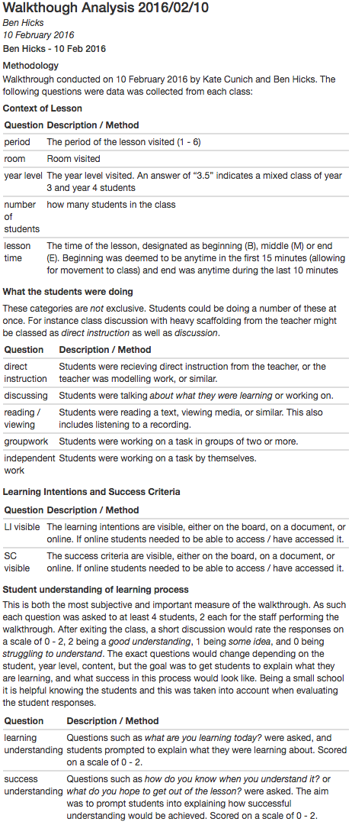
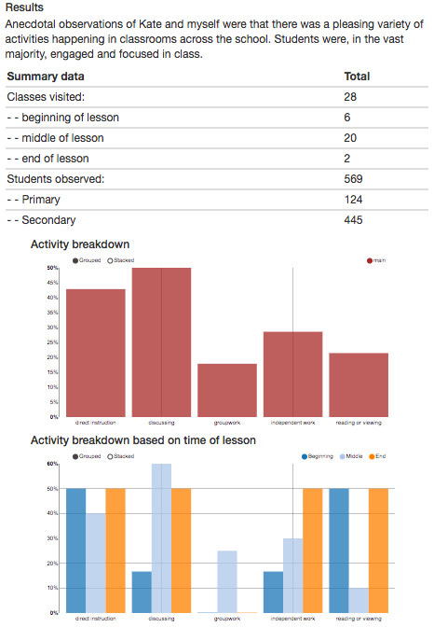
Results
Methodology

Slide 28
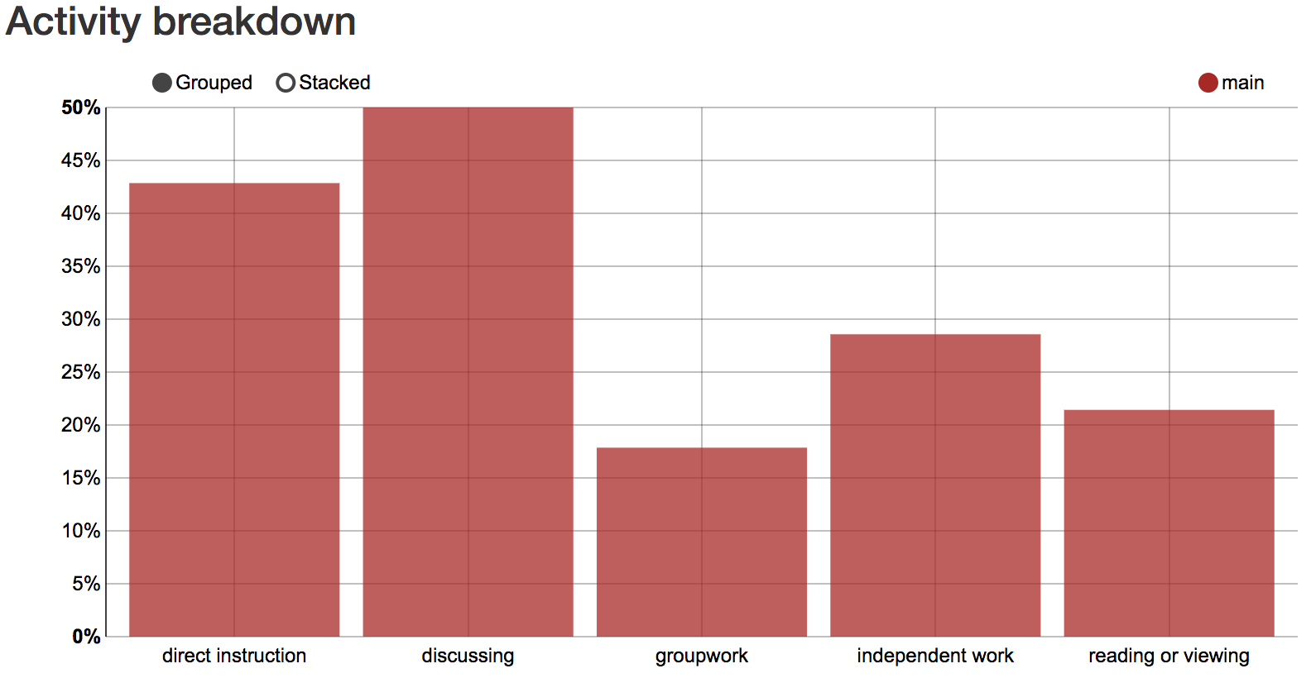

Slide 29
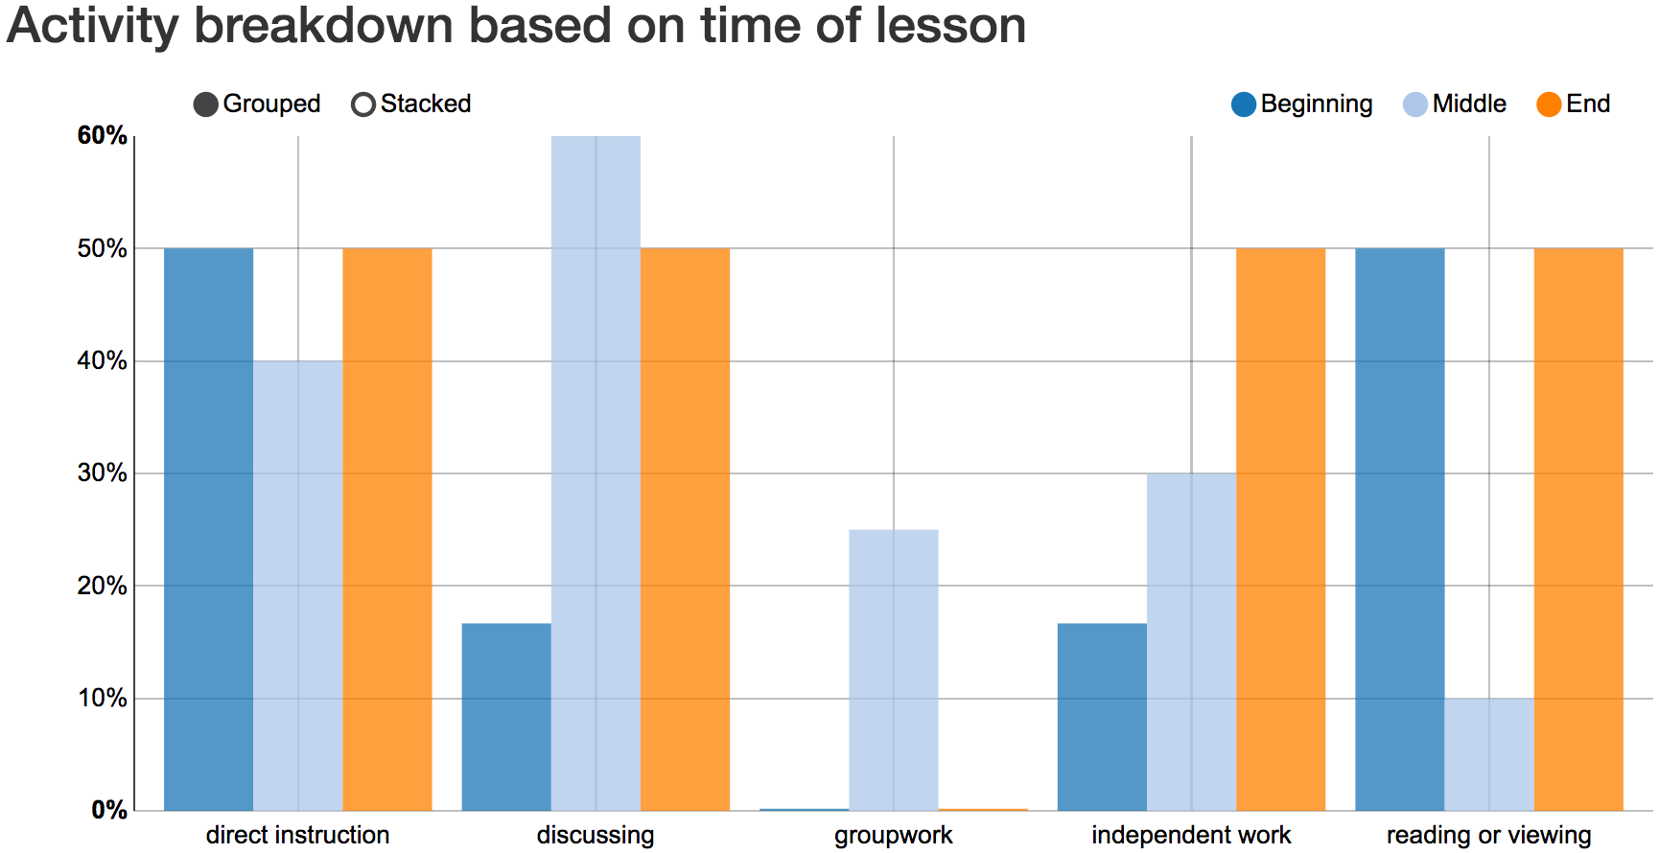

Slide 30
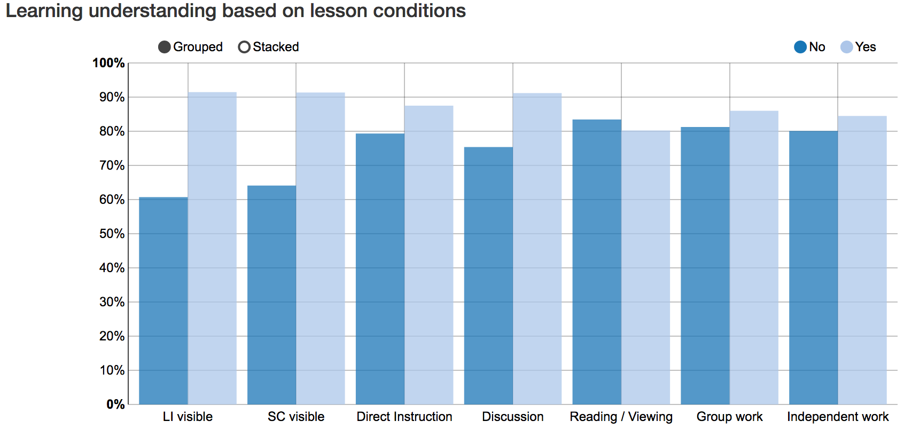
Notes:
Explain graph, and that it is a work in progress – hard to understand!!

Slide 31
Effort reporting
Frame work taken from Nagy (2016):
Students and Teachers report on the student’s effort
3 Categories on a 1 – 5 scale: Diligence, Engagement and Behaviour

Slide 32
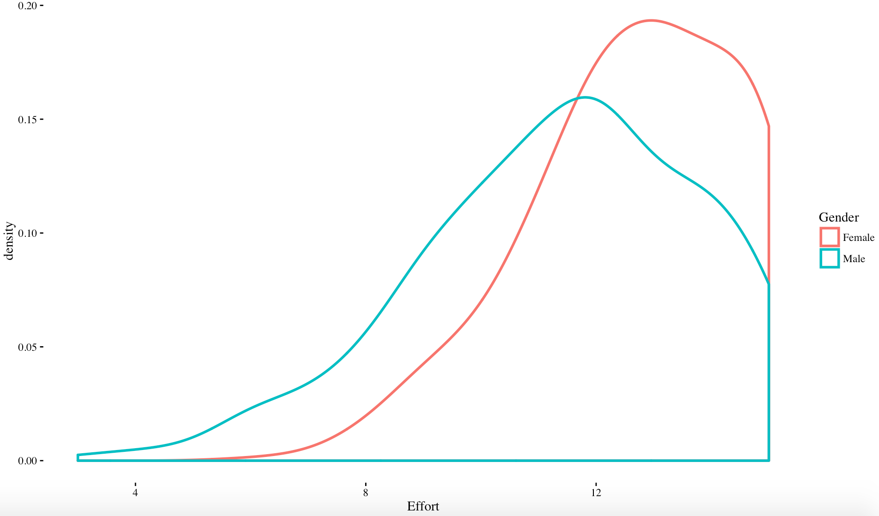
Effort Distribution by Gender
Notes:
Initial graph. Staff were concerned that they were not seeing effort clearly. What did the students think?

Slide 33
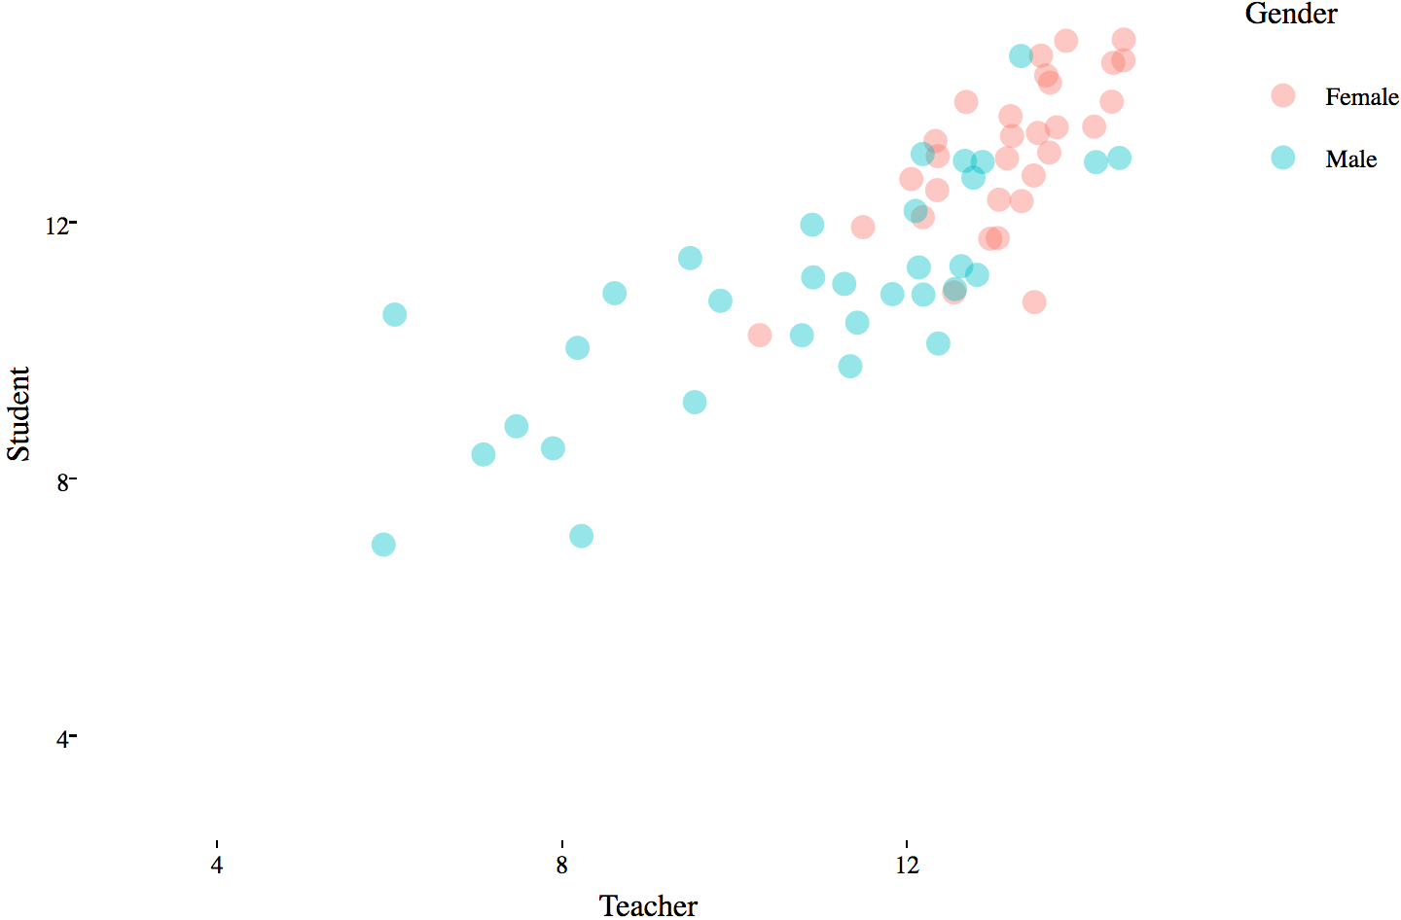
Teacher vs Student Effort Score

Slide 34
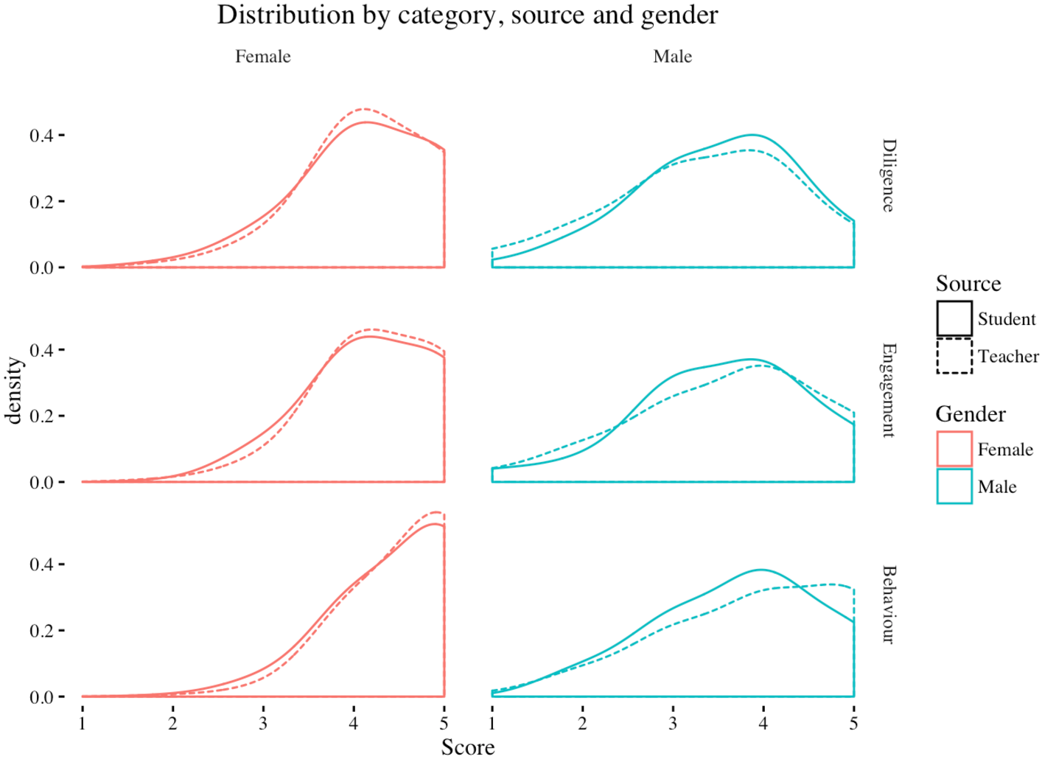

Slide 35
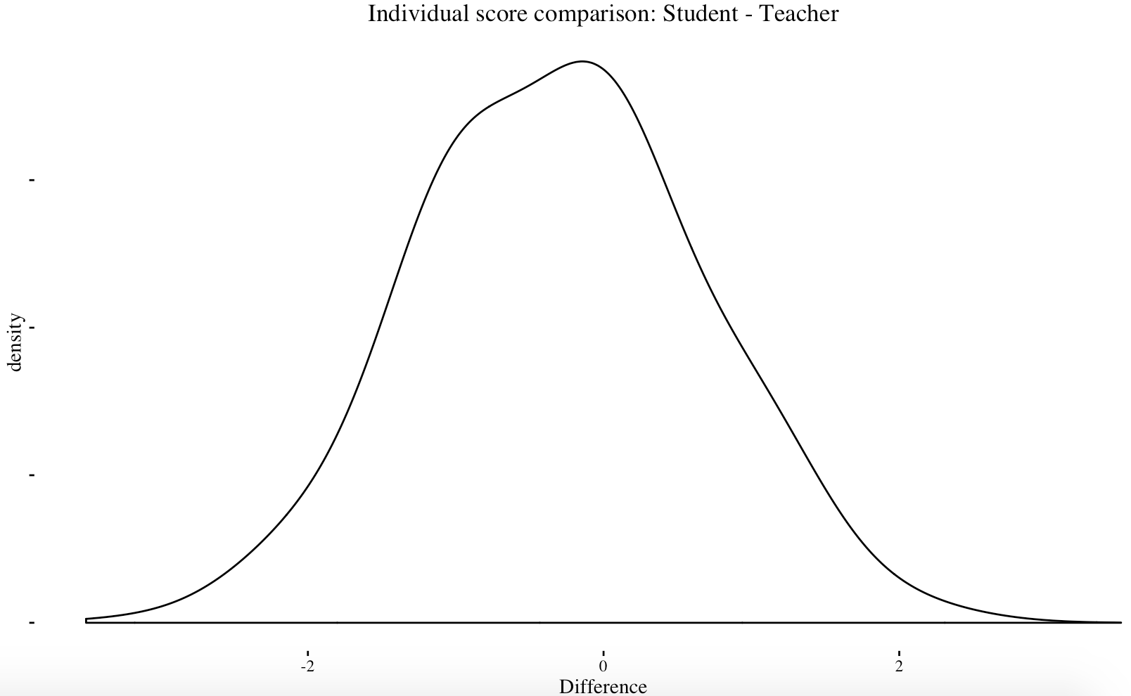

Slide 36
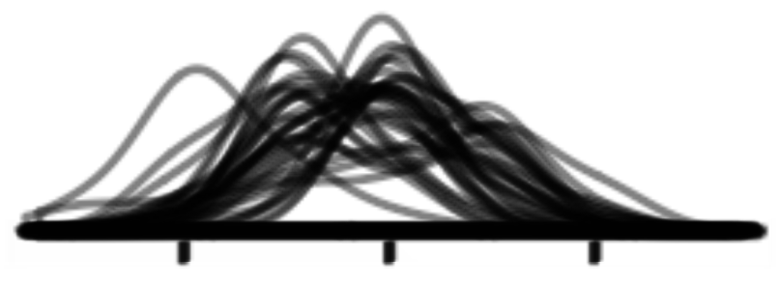

Slide 37
Higher achievement

Slide 38
Lessons – Enabling Dialogue
Build trust. Be transparent. Overshare your methodology.
Choose your delivery method wisely. For discussion, a graph in the hand is worth 10 on the screen.
Allow room for staff to come to their own conclusions. Show don’t tell.

Slide 39
Pitfalls
If you torture the data long enough, it will confess to anything
Darrell Huff
Notes:
Outliers will drive dialogue.
Growth is slippery to measure (regression to the mean, effect size bias, sample size, variation and uncertainty)

Slide 40
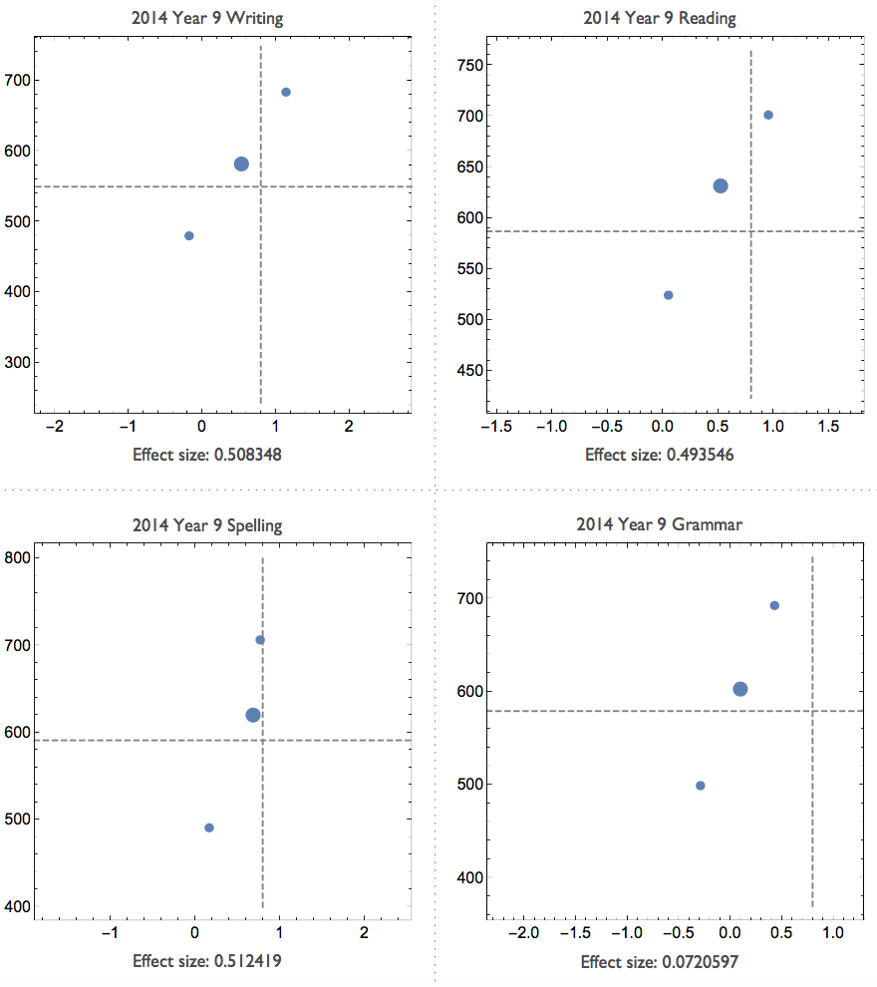
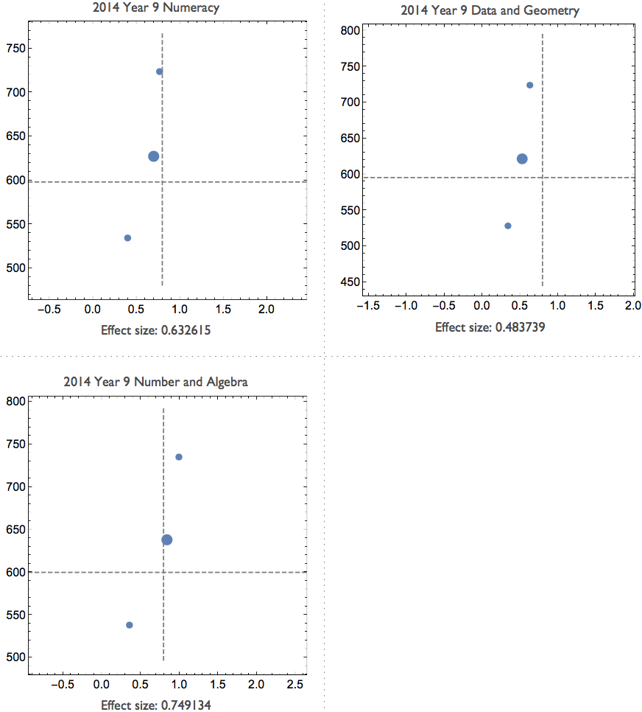

Slide 41
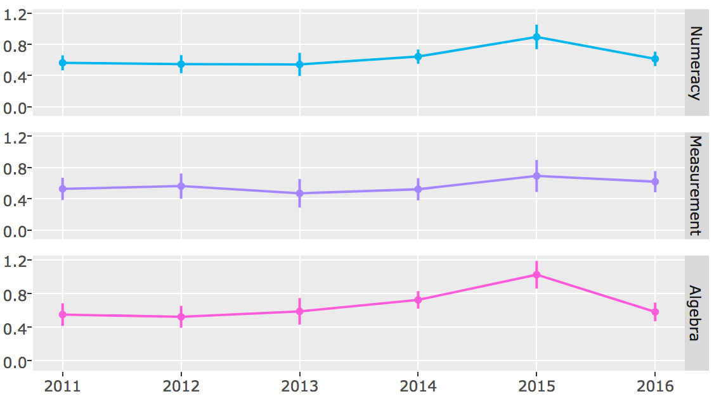
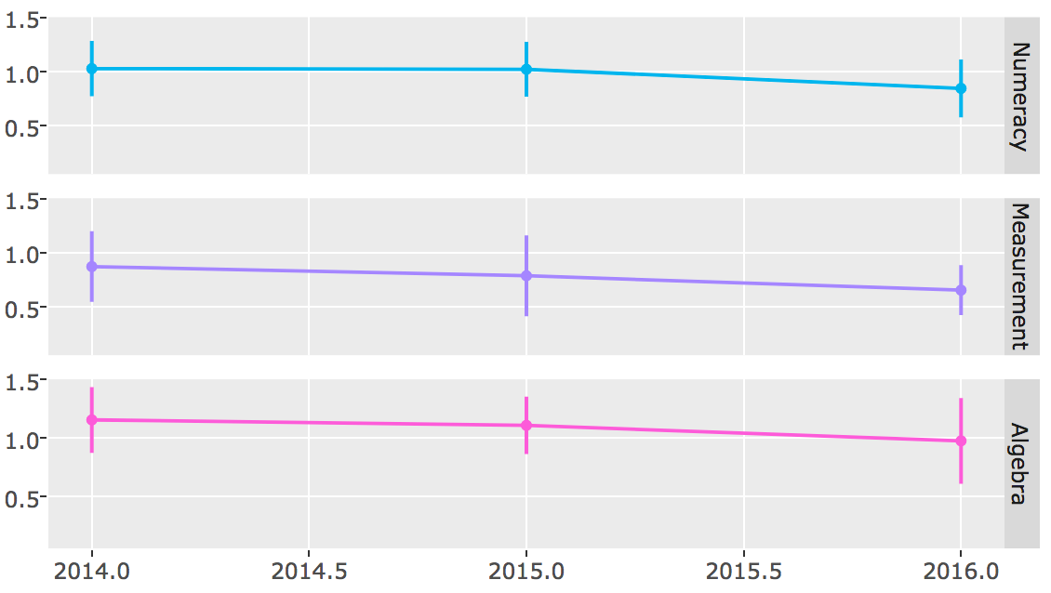
Year 9
Lower overall effect size measure of growth – due to larger spread of the data.
Smaller error due to larger cohort.
Year 5
Higher overall effect size measure of growth.
Larger error due to smaller cohort.

Slide 42
Make sure the data is worth collecting.

Slide 43
Lessons – Pitfalls
Growth can be slippery to measure
Beware of introducing artifacts as you aggregate
Don’t draw precise conclusions from a limited amount data
Before collecting new data ask yourself – ‘can I answer this question with data that already exists?’

Slide 44
Summary
Validate teacher experience
Show don’t tell
Clarity
Trust

Slide 45
Thank you
Ben Hicks
Email:
ben.hicks@oxley.nsw.edu.au
Code shared at:
https://github.com/benwhicks

